Slide 2
Velox
A C++ embeddable evaluation engine
Pedro Pedreira
Software Engineer
26.02.2021

Slide 3
Velox Library
New C++ vectorized SQL evaluation engine
Provide universal and state-of-art building blocks for compute
Embed in various products and services for SQL evaluation
Open source
Hybrid
Why?
Efficiency and Latency
Consistency
Reusability and Engineering Efficiency

Slide 4
Velox Library (2)
Goal is to partially or fully replace other eval engines:
Presto
Spark
Stream Processing (XStream)
Monitoring engines
ML/AI
Custom applications

Slide 5
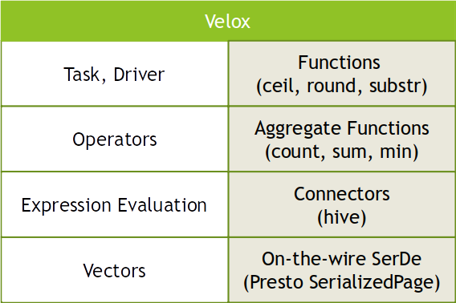
Inside Velox
Not intended to fully replace compute engines
No SQL parser
No Optimizer
Inputs:
single-stage query plan
expression tree
Outputs:
Vectors
Serialized vectors

Slide 6
Use Cases:
Prestissimo

Slide 7
Prestissimo
Prestissimo = Presto on Velox
pres·​tis·​si·​mo | \ pre-ˈsti-sə-ˌmō : faster than presto (used as a direction in music)
Java coordinator with Velox (C++) worker.
Reimplement the full worker http service in cpp.

Slide 8
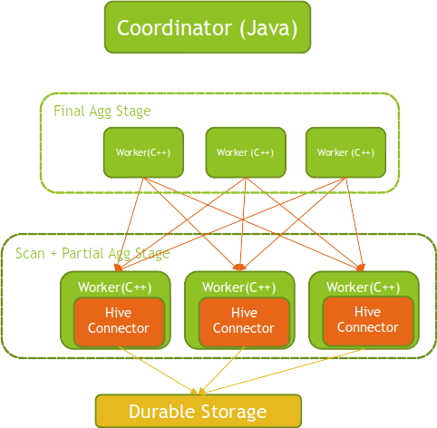

Architecture

Slide 9
Prestissimo
Migrate Presto workloads to C++ over the next 2 years
Efficiency
Reusability
Consistency
Not only compute engines but also client side
Reliability
No more GC storms
Local SSD cache (like RaptorX):
File handlers, ORC footers, metadata, query fragment results, data.
CacheLib: C++ in-process caching library
Open source, production strength, perf on par with the best

Slide 10
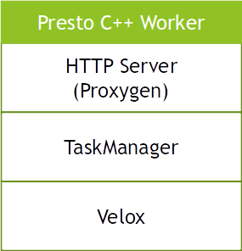
Inside Presto Worker
Two separate repos
Velox library
Presto C++ worker

Slide 11
Use Cases:
Spark

Slide 12
Spark
Offload parts of the Spark eval to Velox
Keep java control plane
metrics, heartbeats, split generation, commit protocol etc.
Velox part of the plan is wrapper into a Transform operator:

Slide 13
Spark + Velox - Architecture
Use Spark transform interface to launch Velox as an external process.
Spark Java Executor serializes plan sends it to the spark_cpp Transform process.

Slide 14
Current Status

Slide 15
Current Status - Velox
Available operators:
TableScan
Hive Connector
FilterProject
Aggregation
TopN
Limit
Repartitioning
Exchange
Many core, string, json and lambda functions.
Join (ongoing)
Spilling (ongoing)

Slide 16
Current Status - Hive Connector
ORC Reader and Writer
CWI is working on Parquet
In memory caching
Local SSD caching via Cachelib (to be open sourced)
Filter pushdown
Aggregation pushdown
Planned:
Aggressive read-ahead
Subfield pruning

Slide 17
Current Status - Prestissimo
Running in shadow mode for initial workloads:
Simple scan, filter, aggregate queries
Caching through cacheLib.
No joins yet.
Initial benchmark numbers:
Results with TCP-H (Q1 and Q6) 50 node cluster:
3 to 4x faster
Real workloads:
Up to 5x cpu time wins.

Slide 18
Current Status - Spark
Shadow 5% of prod traffic (by CPU) this half.
Initial benchmark numbers:
Local mode
1.94x cpu
15% memory efficiency
Cluster mode (Warm Storage):
1.7x cpu
17% memory efficiency

Slide 19
What’s next?
Components shipping in production in H1:
Vectors.
Hive reader/writer.
Expression evaluation.
Integration with a variety of engines
Presto, Spark, Stream Processing, ML/AI, Koski, Saber, Cosco
More benchmarks
Micro, e2e and efficiency.
New features
Hash joins, spilling, shuffle support, better caching.
Investigate benefits of codegen
AI/ML and GPUs

Slide 20
What’s next? (2)
Functions, functions, functions
Long tail.
Core set of functions
Engine specific
External UDF service.

Slide 21
Q/A

